Slide 1

Deliver 1
Image Inpainting
Team 12
Sergio Sancho & Axel Barroso
M2: Optimisation and Inference for Computer Vision
Masters in Computer Vision
Universitat Autònoma
de Barcelona

Slide 2
Summary
Mandatory tasks
Part I: Write the Euler Lagrange Equation
Part II: Numerically solve the equation
Part III: Test with given Images
Optional tasks
Part I: Test with other images
Part II: Solve the problem with an interpolation method
Part III: Extension to color images

Slide 3
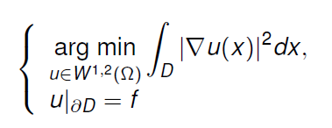
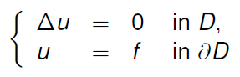
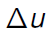
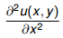
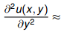
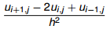
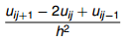
Mandatory tasks
Part I: Write the Euler Lagrange Equation
The goal of this week is get an idea about the optimization problem. We were ask to solve this problem through a given example, the inpainting paradigm. As we know, the inpainting solution u can be found as the minimum of: We also know that after some assumptions over the function and for the derivatives, if function u is a extremum of J(u), then u is solution of the Euler-Lagrange (partial) differential equation
We used the Spatial Gradient for the calculus of the Laplace’s Equation.
=
+
+

Slide 4
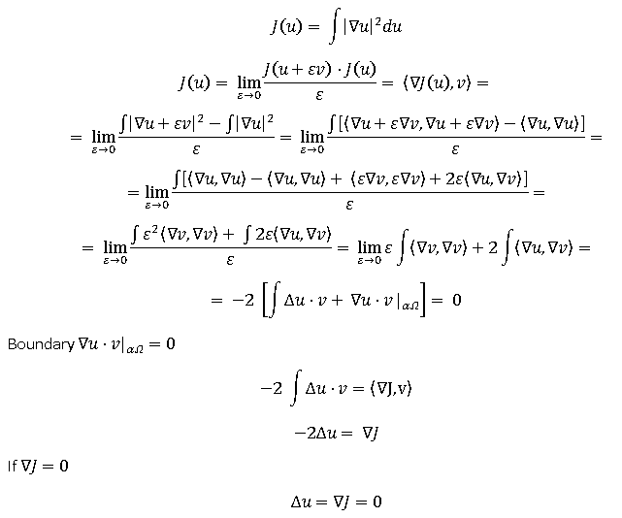
Mandatory tasks
Part II: Numerically solve the equation

Slide 5

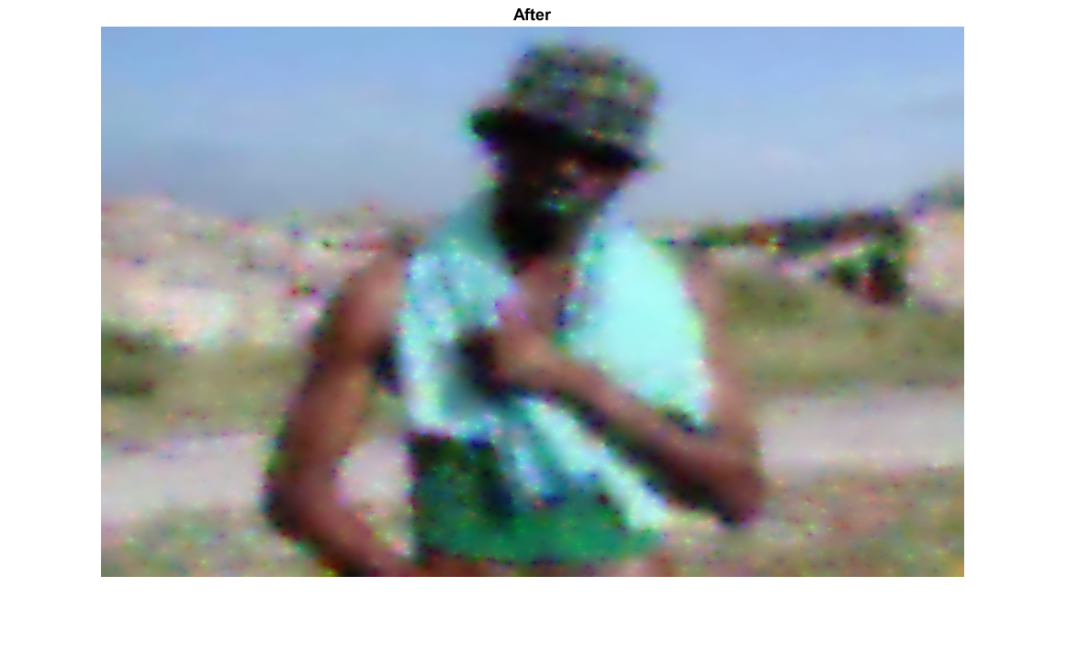
Mandatory tasks
Part II: Numerically solve the equation
We solved the Inpainting problem using differential equations (Laplace’s equation) with Dirichlet boundary conditions for continuity. We represented the problem as a systems of linear equations, Ax=b for x, being x and b column vectors, the restored image and the image to be restored, respectively.
Input image
A
b
Output image
\
=
Img_rows, Img_cols
m, m
m,1
Img_rows, Img_cols
Where
m = w·h,
h = (Img_rows+2),
w = (Img_cols+2)
Reshape m,1 to w, h and eliminate the ghost boundaries.

Slide 6
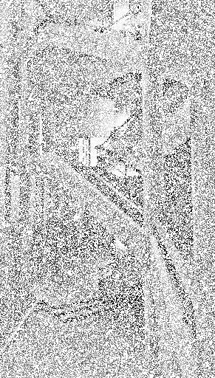
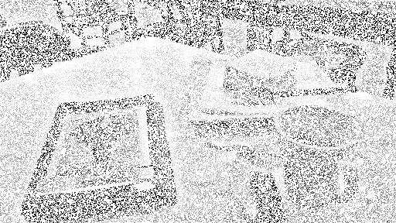
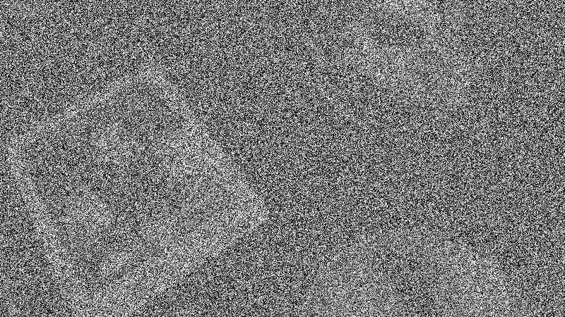
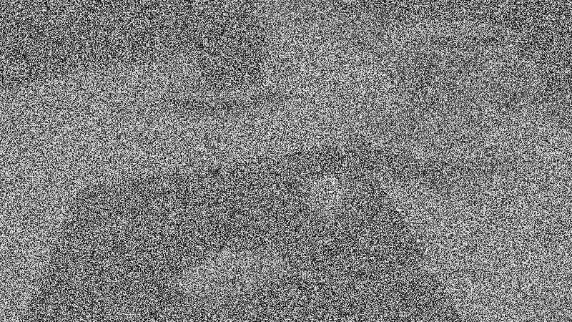
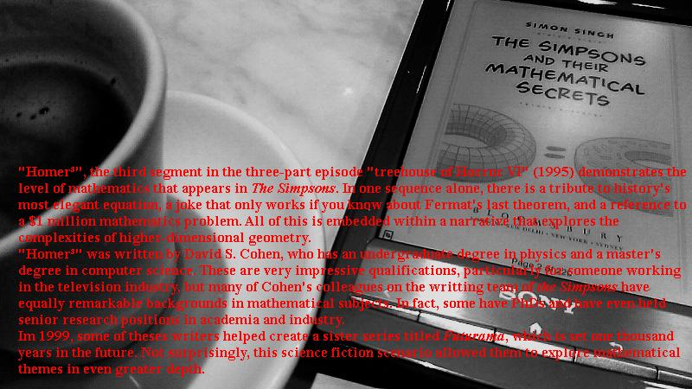
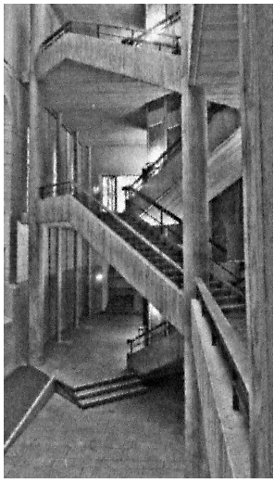
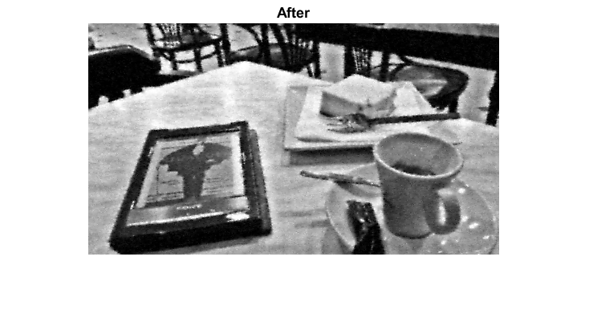
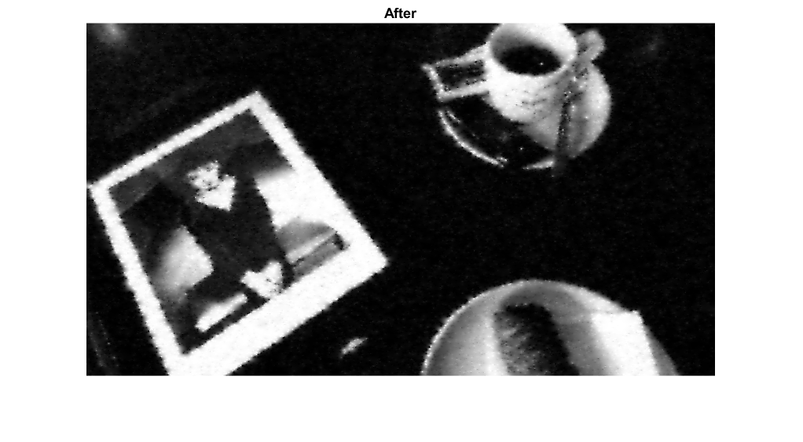
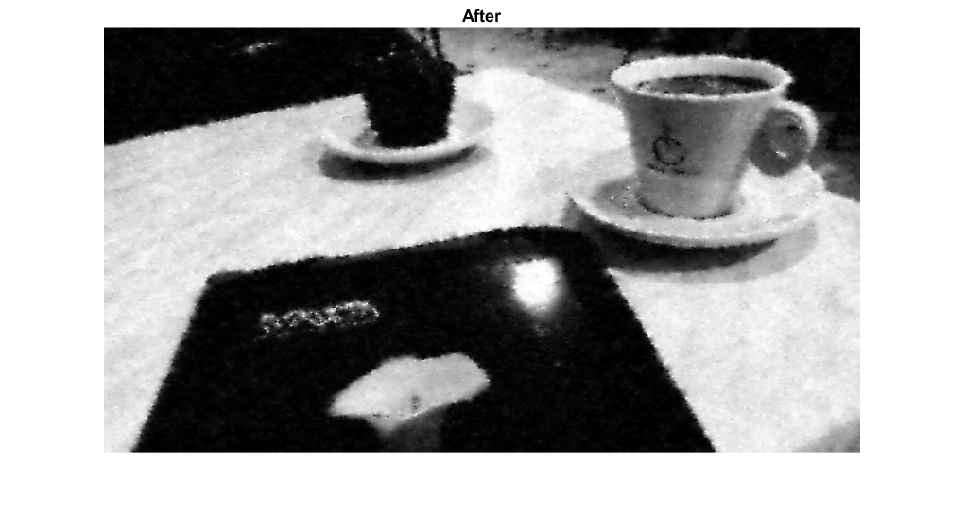
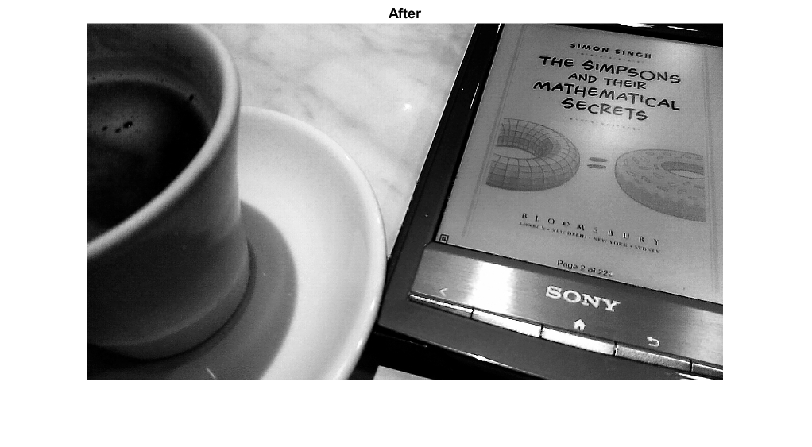
Mandatory tasks
Part III: Test with the given images. Black & White Images
BEFORE
AFTER

Slide 7
Mandatory tasks
Part III: Test with the given images. Challenge Image
1% of information

Slide 8
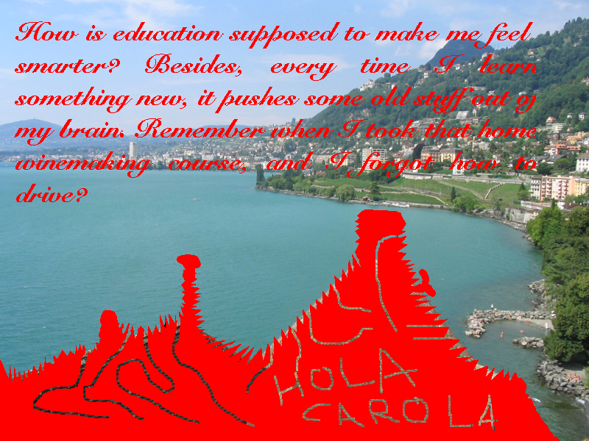
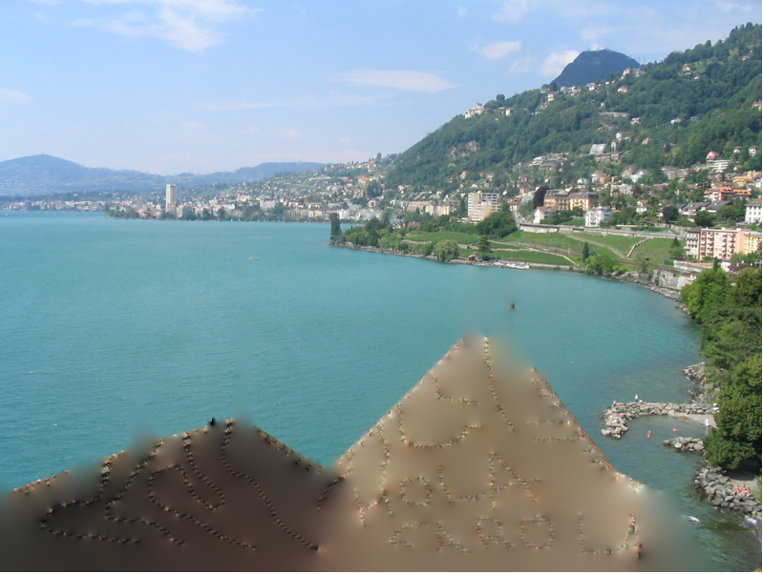
Mandatory tasks
Part III: Test with the given images. Goal Image

Slide 9
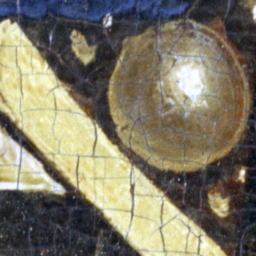
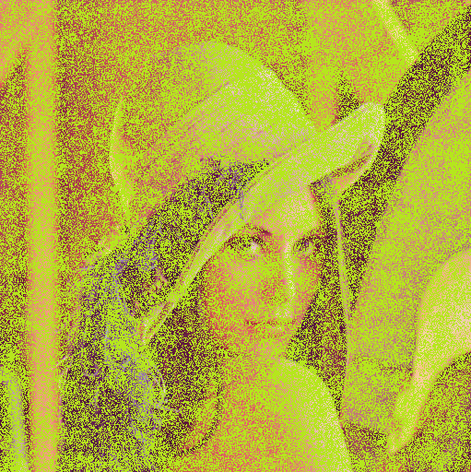
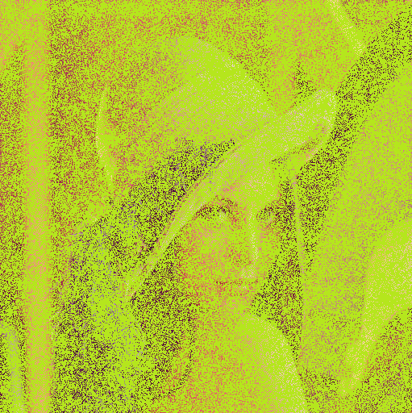
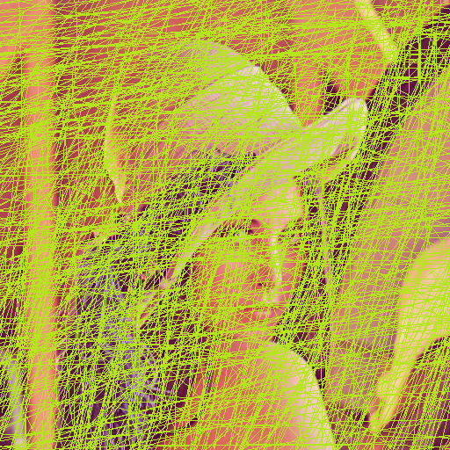
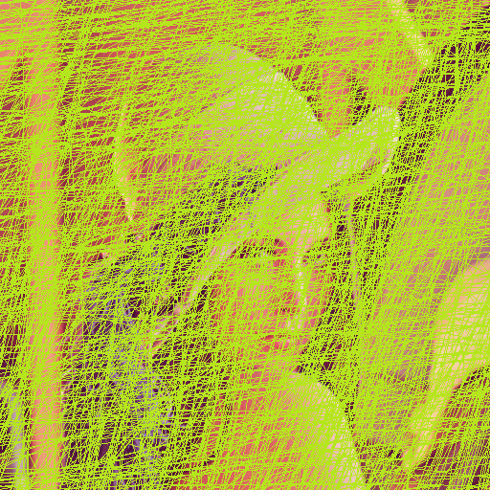
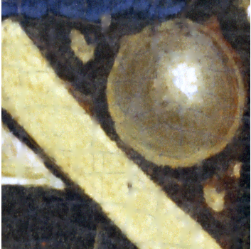
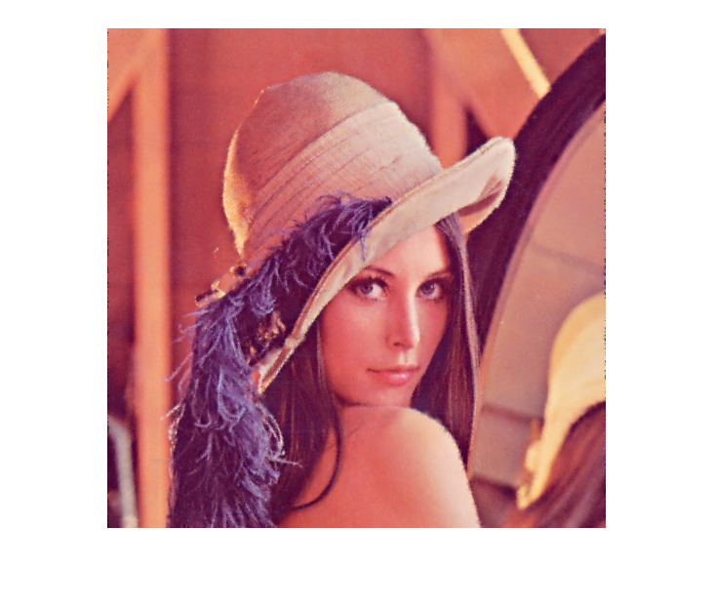
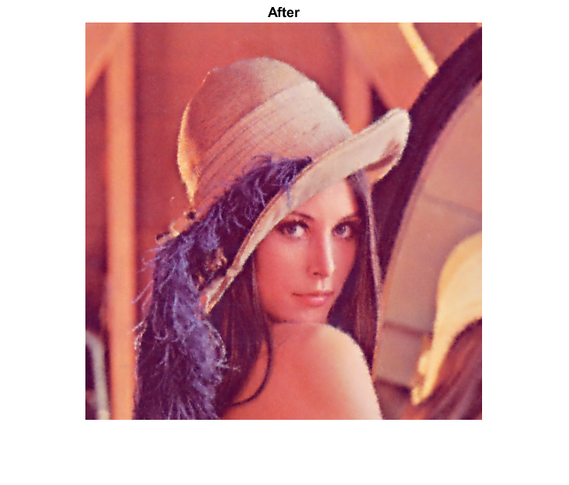


Optional tasks
Part I: Test with other images
BEFORE
Art Gallery Image
40% Information
25% Information
Scratched Image
Extra Scratched Image
AFTER

Slide 10

Optional tasks
Part II: Solve the problem with an interpolation method
We have solved the problem using an interpolation (another NON variational method). In this slide we describe this approach and compare the results with the previous technique.
DESCRIPTION
Our algorithm fills the pixels located on the image mask by linearly interpolating the intensity value of the neighbor pixels in the image to be restored.
RESULTS
Image to be restored
Laplacian solution
Interpolating solution
CONCLUSIONS
Laplacian method outperforms the interpolation in terms of visual results.

